Slide 1

Plant Pathology

Slide 2
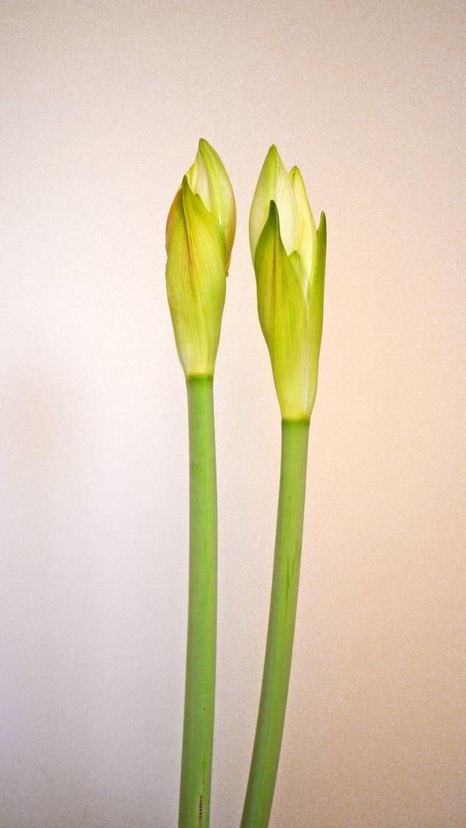
dataset
Plant Pathology 2020 - FGVC7
https://www.kaggle.com/competitions/plant-pathology-2020-fgvc7
Samples :
-images
-train.csv
-test.csv
-sample_submission.csv

Slide 3

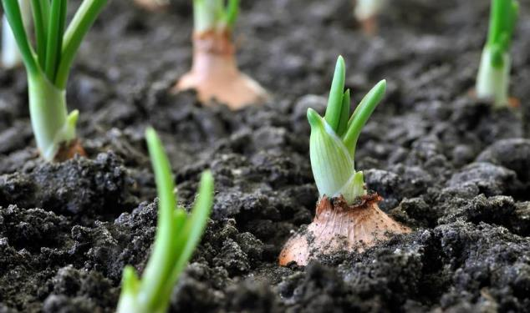
(100, 100,3) 4 classes [healthy ,multiple-disease ,rust ,scab]
testsize = 0.15
(1821 ,100,3,3)
(1821 ,100,3,3)
After augmintaion
testshape :(2459, 100, 100, 3)
trainshape:(13930, 100, 100, 3)

Slide 4
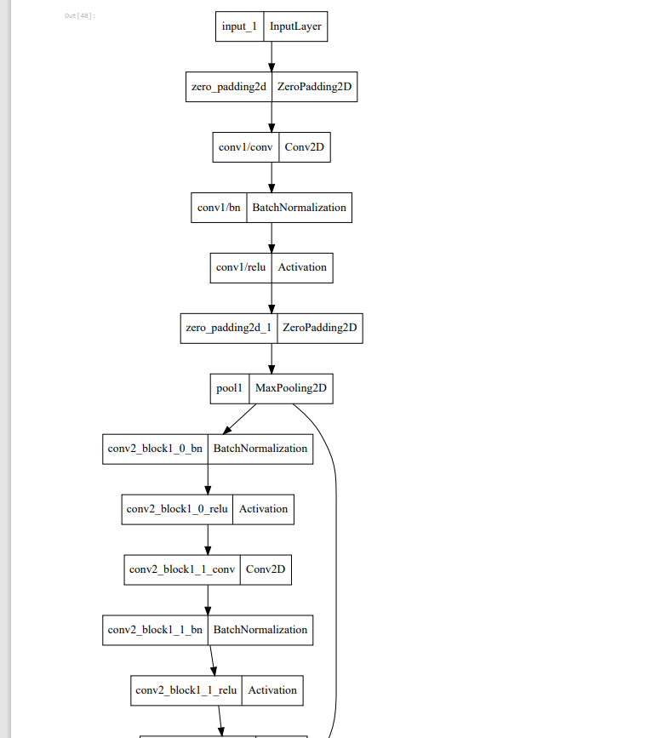
Blockdiagram

Slide 5
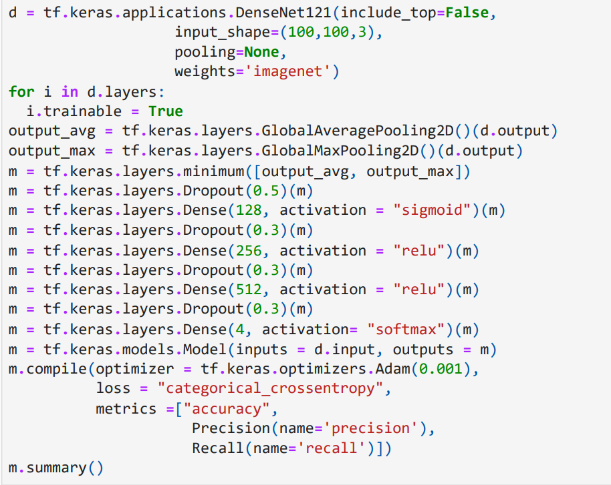
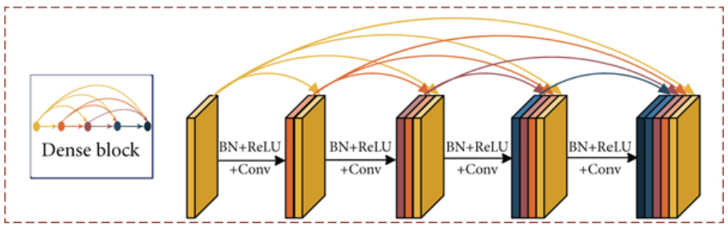
densenet121

Slide 6
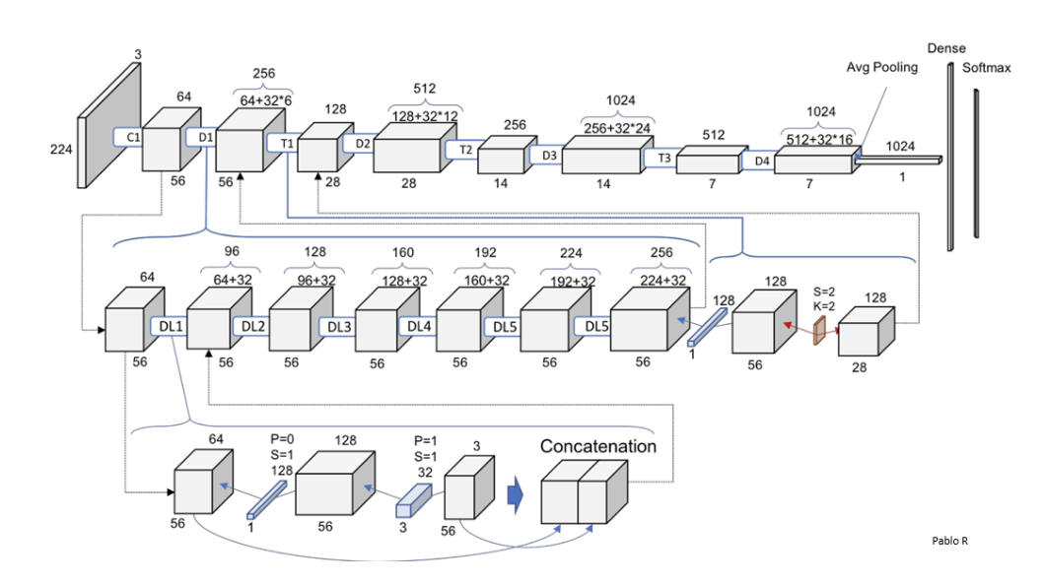

Slide 7
hyperparameter
optimization algorithm(Adam (0.001))
activation function (sigmoid-relu-softmax)
Number of iterations (epochs) in training (20)
drop-out rate(0.3-0.5)
Train-test split ratio

Slide 8
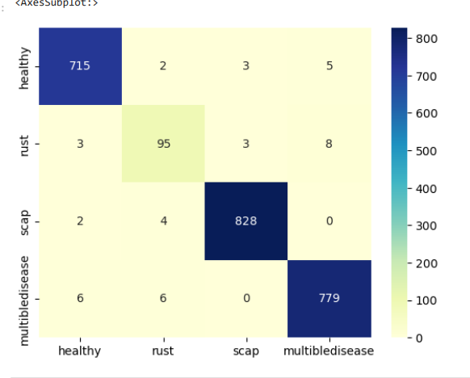
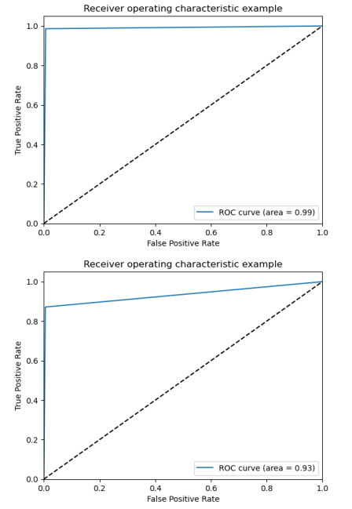
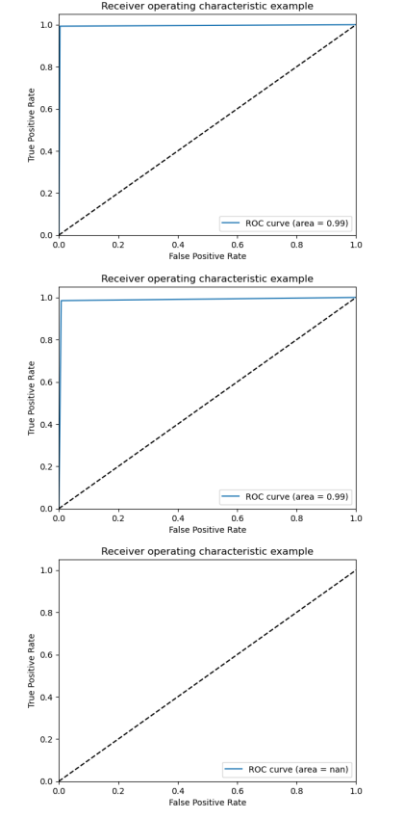
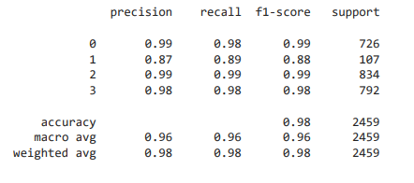

Slide 9


Thank you

